Slide 1
Sales Performance Dashboard Dashboard Design using Power BI
Submitted By: Vivek Vardhan

Slide 2
Objective
To design an interactive Power BI dashboard that helps business stakeholders analyze sales performance, profitability, customer segments, product performance, and regional trends for data-driven decision-making.
Tools Used
Microsoft Power BI
Sample Superstore Dataset
Data Visualization & Business Intelligence Techniques
Dashboard Components Created
KPI Cards
Total Sales
Total Profit
Total Orders
Profit Margin %
Visualizations
Sales Trend Over Time
Sales by Category
Profit by Region
Sales by Segment
Top Products by Sales
Interactivity
Region Filter
Category Filter
Segment Filter
Order Date Filter
Dataset Information
Dataset
Sample Superstore Sales Dataset
Dataset Contains
Order Date
Sales
Profit
Category
Region
Segment
Product Name
Order Details

Slide 3
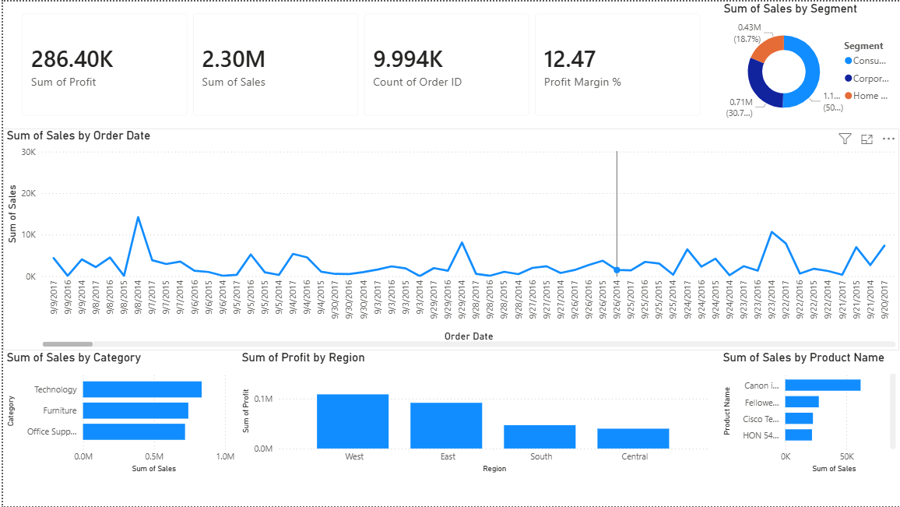
Interactive Sales Performance Dashboard
Dashboard Features
Real-time business performance monitoring
Interactive filtering using slicers
KPI-driven analysis
Trend identification and comparison
Easy-to-understand visual reports
Business Value
Provides a single view of organizational performance and helps stakeholders make informed decisions quickly.

Slide 4
KPI Summary
KPI | Value
Total Sales | 2.30M
Total Profit | 286.40K
Total Orders | 9,994
Profit Margin | 12.47%
Analysis Performed
Sales Trend Analysis
Monitored sales performance across time periods.
Category Analysis
Compared sales among Technology, Furniture, and Office Supplies.
Regional Analysis
Evaluated profitability across different regions.
Customer Analysis
Studied sales contribution from different customer segments.

Slide 5
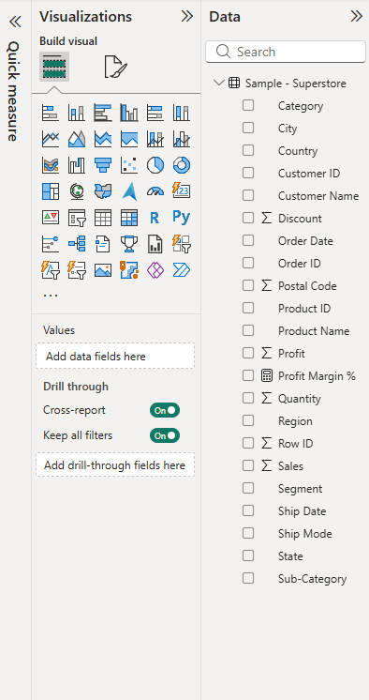
Major Findings
Technology Category
Generated the highest sales revenue among all categories.
West Region
Recorded the highest overall profit.
Consumer Segment
Contributed the largest share of total sales.
Product Performance
A small number of products generated a significant portion of revenue.
Profitability
Business maintained a healthy profit margin of approximately 12.47%.
Impact
These insights help management focus on profitable products, customer groups, and regions.

Slide 6
Business Recommendations
Product Strategy
Increase focus on high-performing products.
Regional Strategy
Expand successful practices from the West region to other regions.
Customer Strategy
Strengthen marketing efforts toward Consumer and Corporate segments.
Profit Improvement
Improve performance in lower-profit categories and regions.
Conclusion
The Sales Performance Dashboard successfully transforms raw sales data into meaningful business insights using Power BI.

